Slide 1
Evaluation of Course Impact
Brno, February 21, 2019
Agnes Simon
Masaryk University
“Learning-centred and Reflective Teaching. From Theory to Good Practice”

Slide 2
Data and Methods
Data provided from 12 graduates of cohort 1
Surveys at three points
Before course
After the summer school
After graduation
Assignments at two points
Early on | At the End
Microteaching reflection paper | Innovation reflection paper
Application teaching essay | Statement of teaching philosophy
Notes:
Survey → Pre-Post Study where possible
Quanti: frequencies, counts, one-sided paired t-tests, p<0.5
Qualitative
Assignments → Pre-Post Design between assignments of similar nature
Quanti: frequencies, crosstab with chi-square→small sample size p<.10
Plan for further analysis—will talk about it as we go along

Slide 3
SURVEYS General Impact: Knowledge of teaching and learning
On a scale of 1–10, 1 being very little, and 10 being a lot, how much do you think you know about teaching and learning?

Slide 4
SURVEYS General Impact: Confidence
On a scale of 1–10, 1 marking having very little confidence and 10 being very confident, how confident do you feel as a teacher?

Slide 5
Course Objectives
Student centeredness
Reflective and critical thinking
Use of theory

Slide 6
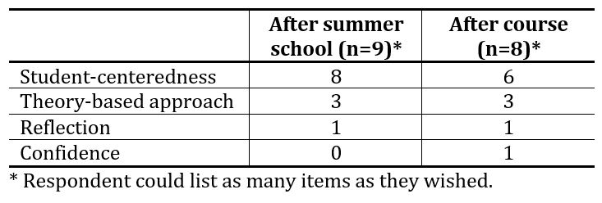
SURVEYS Course Objectives: Change in Attitude
75% said their attitude changed
Nature of change:

Slide 7
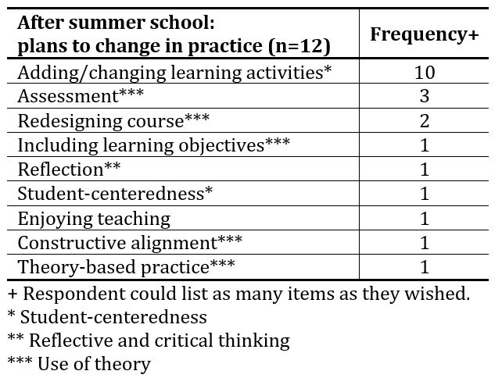
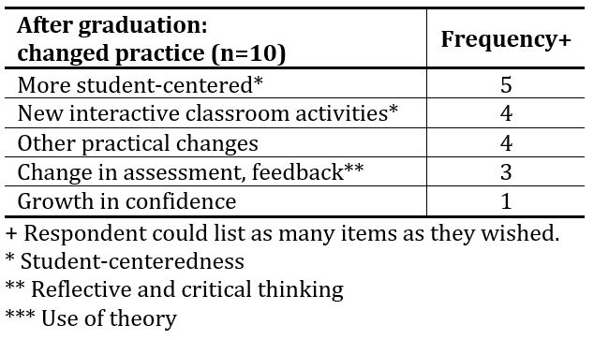
SURVEYS Course Objectives: Change in Practice
After Summer School
After Graduation
Everyone planned to change teaching practice
Nature of change:
All but one said they changed teaching practice
Nature of change:

Slide 8
ASSIGNMENTS Student-Centeredness
Reflection Papers
Teaching Essays
n=12
χ²=7.2
df=2;
p=0.027
Statistically significant difference
n=12
χ²=3.273
df=2
p=0.195
No statistically significant difference

Slide 9
ASSIGNMENTS Reflective and Critical Thinking
Reflection Papers
Teaching Essays
n=12
χ²=0.444
df=2
p=0.801
No statistically significant difference
n=12
χ²=4.0
df=3
p=0.261
No statistically significant difference

Slide 10
ASSIGNMENTS Use of Theory
Reflection Papers
Teaching Essays
n=12
χ²=7.556
df=3
p=0.056
Statistically significant difference
n=12
χ²=8.40
df=4
p=0.078
Statistically significant difference

Slide 11
(Preliminary) Conclusions
Surveys
Assignments
Noticeable impact on student-centeredness
Very little impact on reflectiveness
Some impact on use of theory
Some impact on student-centeredness
No impact on reflectiveness
Noticeable impact on use of theory

Slide 12
Puzzles
Generally, a strong impact on knowledge and confidence
Different data sources show different impact across course objectives
Notes:
Not clear that the problem is in data coding OR the impact is really not there.

Slide 13
Future plans
Coach vs expert coding
Soft data:
Post-course interviews with participants
Actual wording of assignments
Include cohort 2 in analysis

